Slide 1
TRADERS NORTHWIND TRADERS SALES ANALYTICS
Excel. Power BI · SQL · EDA·
BY:
Pravallika Manepalli

Slide 2
Table of Contents:
Project Overview
Objectives
Dataset & Tables
Data Model
Dashboard Pages
KPIs & Insights
Business Challenges
Solutions
Conclusion
Future Improvements

Slide 3
Project Overview:
Collected Northwind Traders sales data from Excel and database tables
Imported datasets into SQL and Power BI environment
Performed SQL queries for data extraction, filtering, joins, aggregation, and analysis
Cleaned and transformed raw data using Power Query Editor
Removed duplicate and null values and standardized data types
Built a Star Schema data model with fact and dimension tables
Created relationships between orders, customers, employees, products, and suppliers tables
Developed DAX measures and calculated KPIs for business analysis
Designed interactive dashboards for Sales, Customer, Employee, and Inventory analysis
Used charts, slicers, maps, KPI cards, tree maps, and waterfall visuals for insights
Generated business insights to improve sales tracking, employee performance, and inventory monitoring
Created a professional business intelligence reporting solution for decision-making support

Slide 4
Business Requirements
Identify overall sales performance and revenue trends
Track top-performing products and categories
Analyze customer purchasing behavior and repeat customers
Monitor employee sales performance and order handling
Compare sales across countries and cities
Track inventory stock levels and reorder requirements
Analyze shipping performance and delivery duration
Build interactive dashboards for easy business monitoring
Enable faster data-driven decision making

Slide 5
PROBLEM STATEMENT
Business data was spread across multiple tables and files
Manual analysis was time-consuming and difficult
Identifying sales trends and customer behavior was challenging
Inventory monitoring and employee performance tracking lacked proper visualization
Decision-making was difficult without interactive reporting tools
The organization required a centralized dashboard for business insights

Slide 6
PROJECT OBJECTIVES
Analyze sales performance
Study customer behavior
Monitor inventory
Evaluate employee performance
Perform SQL analysis
Create interactive dashboards
Generate business insights

Slide 7
Source: Northwind Traders — Relational Sales Database
Data Source & Tables Used
Table Name | Description
Orders | Customer order details
Order Details | Product sales transactions
Customers | Customer information
Employees | Employee records
Products | Product details
Categories | Product categories
Suppliers | Supplier information
Shippers | Shipping company details

Slide 8
End-to-End Workflow
Excel / CSV Files
↓
CSV Files Cleaned & Data Types Standardized
↓
Imported into SQL Database
↓
SQL Queries & Data Analysis
↓
Data Cleaning in Power Query
↓
Data Modeling & Relationships
↓
DAX Measures & KPI Creation
↓
Dashboard Development in Power BI
↓
Business Insights & Reporting

Slide 9
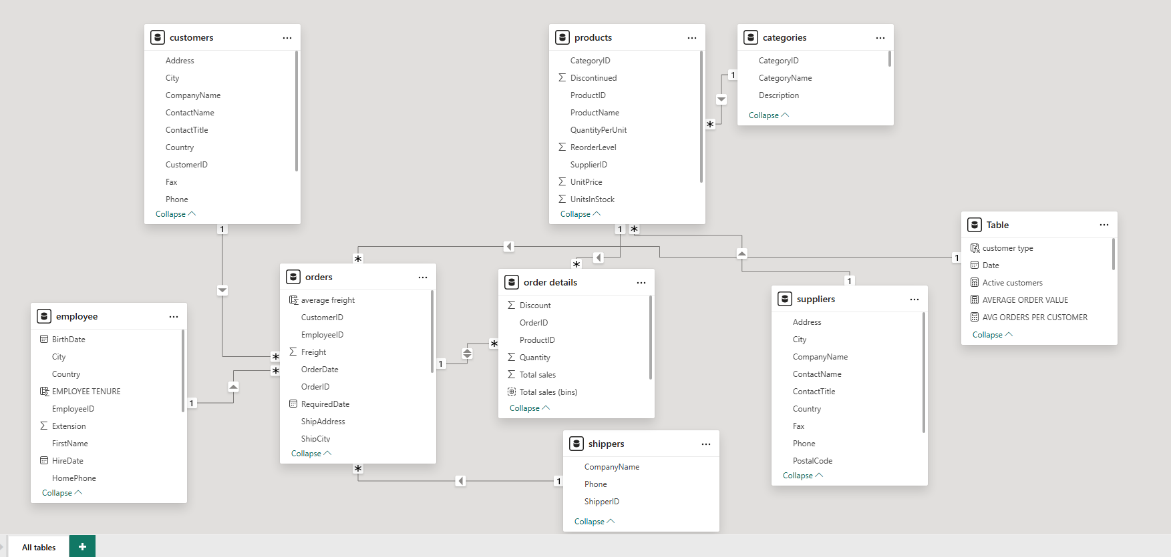
DATA MODEL / STAR SCHEMA
A star schema data model was created for efficient analysis
Order Details table was used as the fact table
Customers, Products, Employees, Suppliers, Categories, and Shippers were used as dimension tables
Relationships were created using primary and foreign keys
Proper relationships improved filtering and dashboard performance

Slide 10
Dashboard Overview
Dashboard | Description
Executive Overview Dashboard | Displays overall KPIs, revenue trends, customer count, supplier metrics, and shipping performance
Sales & Product Analysis Dashboard | Analyzes sales trends, top-selling products, category performance, and product pricing distribution
Customer Analysis Dashboard | Tracks customer distribution, order trends, customer segmentation, and regional analysis
Employee Performance Dashboard | Evaluates employee order handling, sales contribution, and workforce performance metrics
Supplier & Operations Dashboard | Monitors supplier distribution, shipping efficiency, operational timelines, and logistics insights

Slide 11
KEY KPIs & BUSINESS METRICS
1.78K
$0.08M
8.65 Days
$1.35M
TOTAL REVENUE
Average order value
Total Discount Given
Average shipping duration
760
92
9
$150.50K
2.22K
Total Orders
Total Customers
Total Employees
Avg Revenue / Employee
Sum of unit price
OPERATIONAL INSIGHTS
99%
89%
8.26
77
3119
780
Repeat Customers
Active Customers
Average orders per
customer
Total customers
Units in stock
Units on order

Slide 12
POWER BI DASHBOARD WALKTHROUGH
5Power BI pages — page-by-page summary
PAGE 1 — Executive Overview Dashboard
PAGE 2 — Sales & Product Analysis Dashboard
Revenue KPIs | Order trends | Customer metrics | Supplier overview | Shipping performance
Monthly sales trends | Product category analysis | Top-selling products | Product pricing distribution
PAGE 3 — Customer Analysis Dashboard
PAGE 4 — Employee Performance Dashboard
Customer distribution | Regional customer insights | Order trends | Customer segmentation analysis
9 Employees | 150.50K Revenue/Employee | Employee sales trend | Orders handled analysis
Supplier distribution | Shipping timelines | Operational efficiency | Inventory
PAGE 5 –Regional And Supplier Dashboard

Slide 13
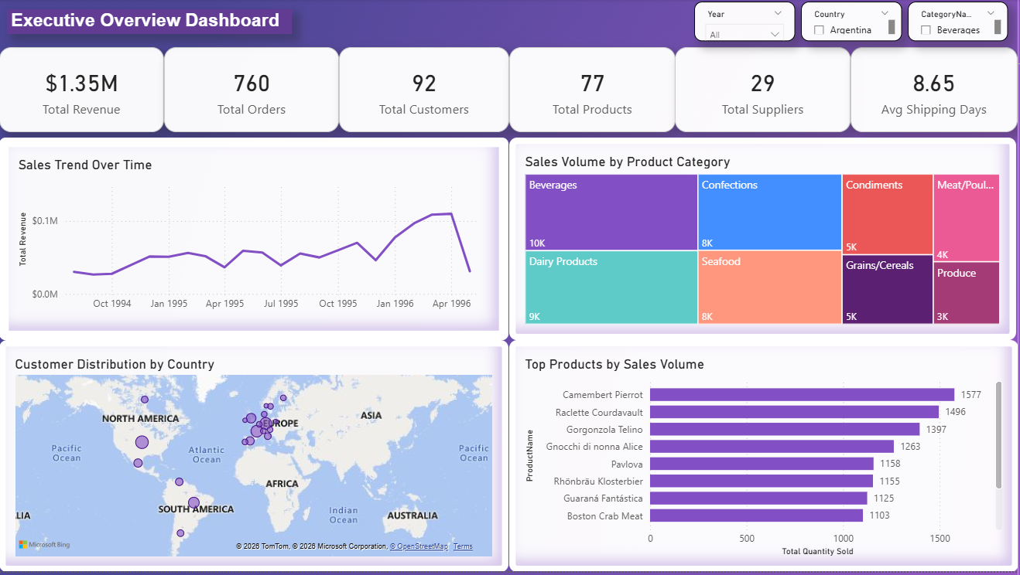
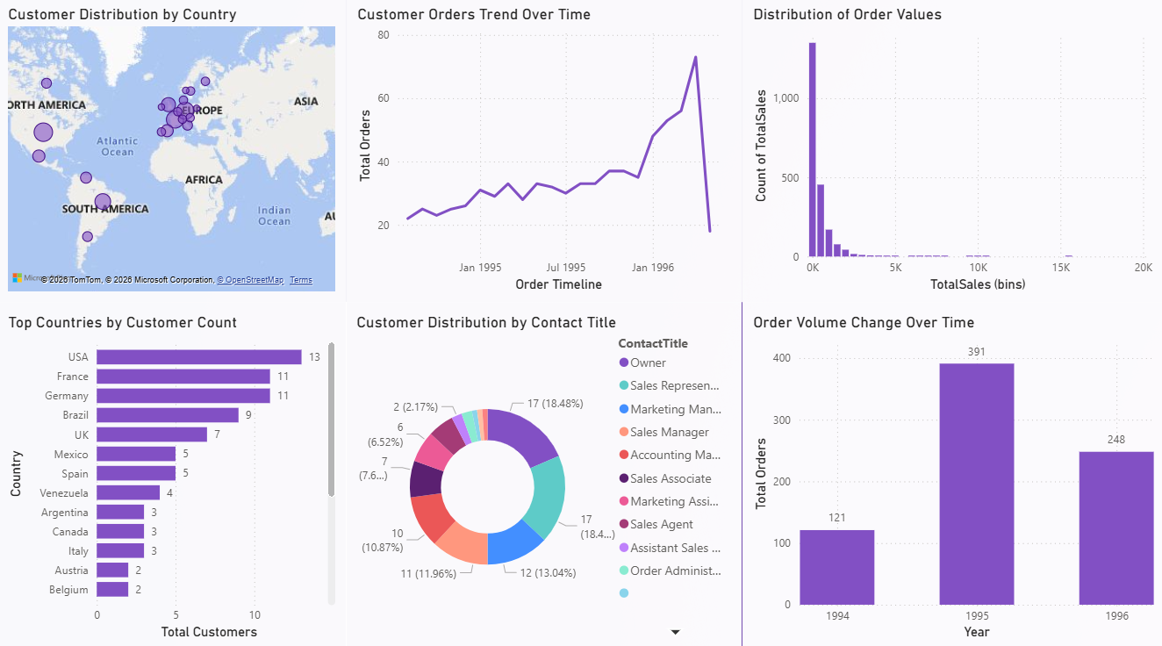
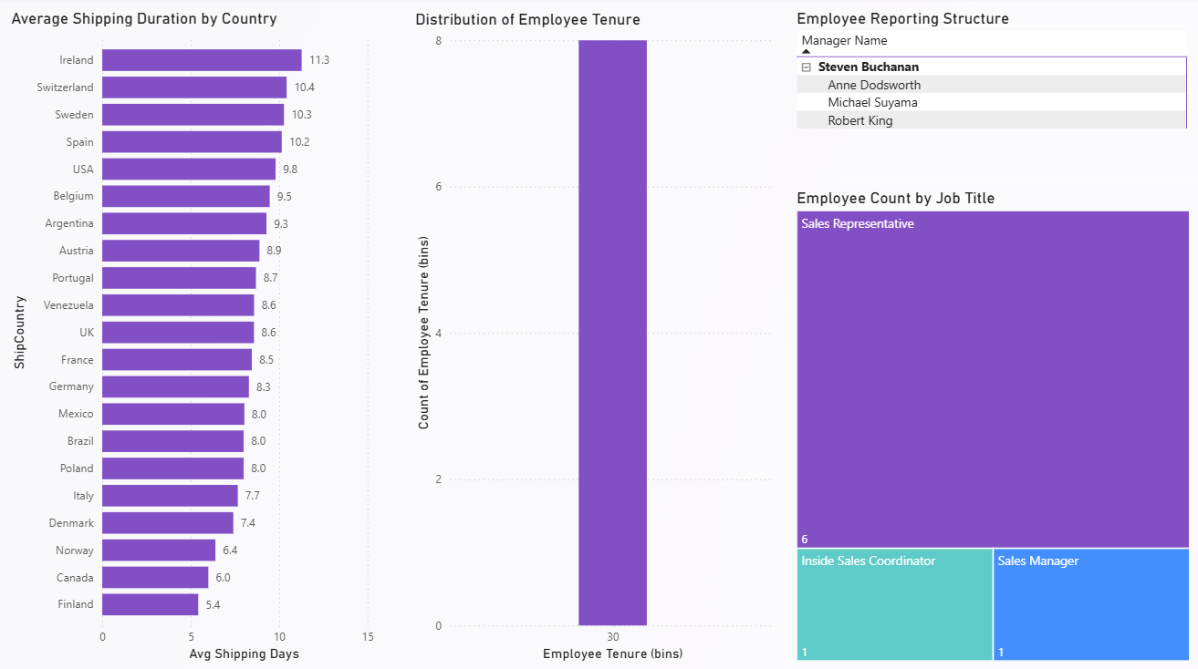
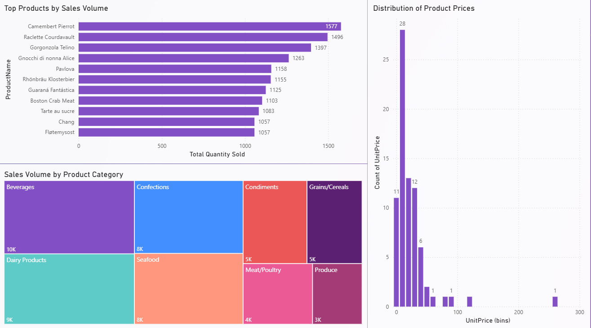
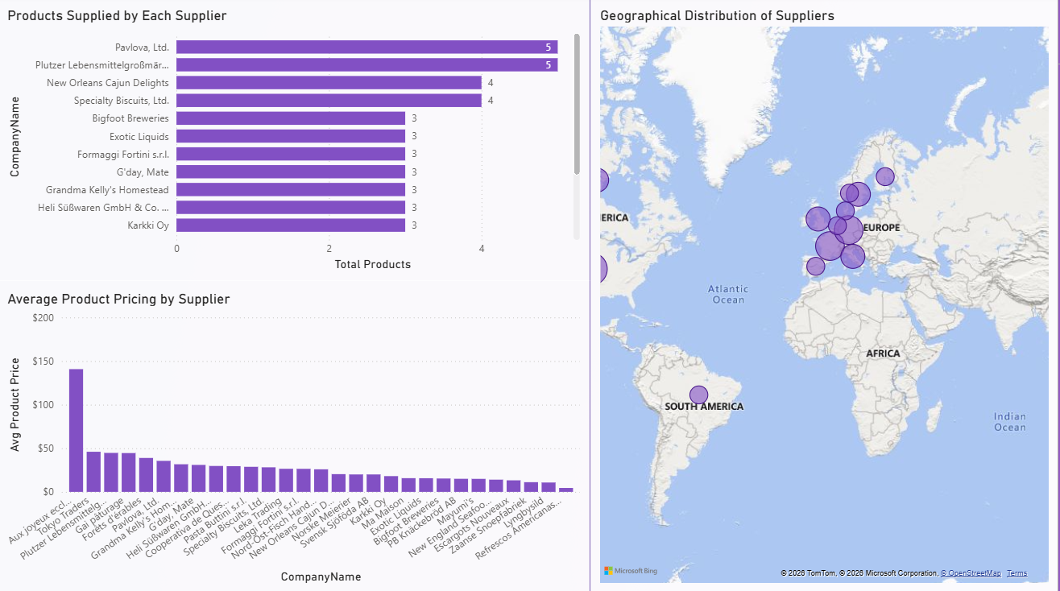
DASHBOARD VISUALS
Interactive Dashboard Visualizations
Customer Analysis Dashboard
Employee Analysis Dashboard​
Product and Sales Analysis Dashboard
Supplier and Regional Analysis Dashboard
Product stock availability and inventory distribution insights
Customer behavior and repeat cusomer analysis
Country-wise revenue and geographic sales distribution

Slide 14
BUSINESS CHALLENGES & ANALYTICAL SOLUTIONS
PROBLEM | SOLUTION | IMPACT
No centralized sales tracking | Created Sales Performance Dashboard | Better revenue monitoring
Customer behavior not analyzed | Built Customer Analytics Dashboard | Improved customer insights
Employee performance unclear | Developed Employee KPI Dashboard | Employee productivity tracking
Inventory stock monitoring difficult | Built Inventory Dashboard | Reduced stock management issues
Geographic sales analysis missing | Added country-wise revenue analysis | Better regional business decisions
SQL + Excel + Power BI used for business analysis and dashboard development

Slide 15
BUSINESS IMPACT & DECISION VALUE
From Data to Decisions — Measurable Business Value
Area | Business Challenge | Business Outcome
Executive Reporting | Fragmented manual reporting | Centralized KPI dashboards
Sales & Product Analysis | Limited revenue visibility | Interactive sales and product insights
Customer Analysis | Difficulty tracking customer behavior | Customer segmentation and regional insights
Employee Performance | Limited workforce visibility | Employee productivity analysis
Supplier & Operations | Shipping inefficiencies difficult to identify | Operational and logistics optimization
Strategic Decision Making | Slow analytical process | Faster data-driven decisions
WAS
Interactive dashboards improved reporting efficiency, operational visibility, and business decision-making.
WAS

Slide 16
PROJECT CONCLUSION & FUTURE ENHANCEMENTS
& FUTURE
SCOPE
PROJECT SUMMARY
• Developed interactive Power BI dashboards for business intelligence reporting • Integrated SQL, Excel, EDA, and Power BI for end-to-end analytics • Performed data cleaning, transformation, and KPI modeling • Built executive, sales, customer, employee, and operations dashboards • Generated actionable insights for revenue, customer behavior, and operational performance • Improved decision-making through interactive visual analytics and KPI tracking
FUTURE ENHANCEMENTS
• Real-time database connectivity using SQL Server or cloud integration • Automated alerts and scheduled reporting through Power BI Service • Predictive sales forecasting using machine learning models • Mobile-responsive dashboard optimization • Advanced customer segmentation and trend prediction • Integration with live business data sources for real-time analytics
Built using SQL, Excel, Exploratory Data Analysis (EDA), and Power BI for business intelligence and analytical reporting.

Slide 17
CONCLUSION
& FUTURE
SCOPE
FUTURE ENHANCEMENTS
⚡
Live Data Pipeline
Connect via SQL Server DirectQuery for real-time dashboard updates
🔔
Automated Alerts
Enable automated KPI and operational alerts using Power BI Service
PROJECT SUMMARY
🤖
Predictive Sales Forecasting
$1.35M revenue analyzed across 760 orders
Integrate machine learning models for future revenue and demand prediction
5 interactive Power BI dashboards created
🌐
SQL, Excel, EDA, and Power BI used for analytics
Dashboard Publishing
Power BI Service deployment for secure executive report sharing
KPI and DAX-based business reporting implemented
📱
Mobile Dashboard
Insights generated for sales, customers, employees, and operations
Responsive mobile layouts for on-the-go executive access
Built with Power BI · SQL · DAX · Excel | Northwind Analytics 2025

